Slide 1













N.B.K.R Institute Of science and technology
FLIGHT BOARDING
PRIORITY SYSTEM
Team Project By:-SK.MUBARAK(24kb1a05hx)
SK.JAFAR(24kb1a05hn)
P.TEJA(24kb1a05ed)

Slide 2

Introduction
"We've all experienced the sometimes stressful process of boarding a flight, often involving long lines and a general rush to find our seats. Now we're going to explore a more organized and considerate approach known as a Flight Boarding Priority System. This system strategically assigns different boarding priorities to specific groups of passengers, such as senior citizens, families, and even solo travelers, aiming to create a smoother and more efficient experience for everyone involved."

Slide 3
01.
Minimize boarding time and Improve passenger satisfaction
OBJECTIVES
02.
Enhance airport and airline efficiency.improve transport efficientcy
03.
Ensure fairness in the boarding process and less time manegement

Slide 4
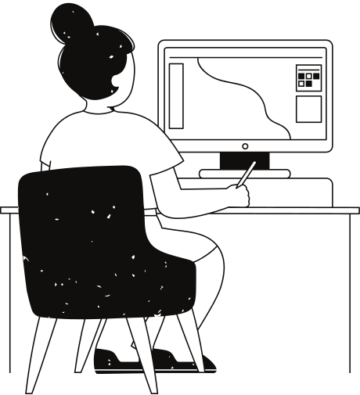
ALGORITHM
Step 1:
Initialize the Priority Queue
Ask the user for the queue capacity.
Allocate memory and initialize the priority queue.
Step 2:
Display Menu and Get User Choice
Show options (Add, Dequeue, Peek, Display, Exit).
Read the user's menu choice.
Step 3:
Add Passenger (if chosen)
Take name and type of passenger.
Assign priority:
Senior Citizen → 3
Family → 2
Solo Traveler → 1
Insert passenger in the queue according to priority.
Step 4:
Process Queue Operations (Dequeue / Peek / Display)
Dequeue: Remove and show the passenger with highest priority.
Peek: Show the next passenger without removing.
Display: Show all passengers in the queue.
Step 5:
Repeat or Exit
Repeat Steps 2–4 until user selects "Exit".
Free allocated memory and end the program.

Slide 5
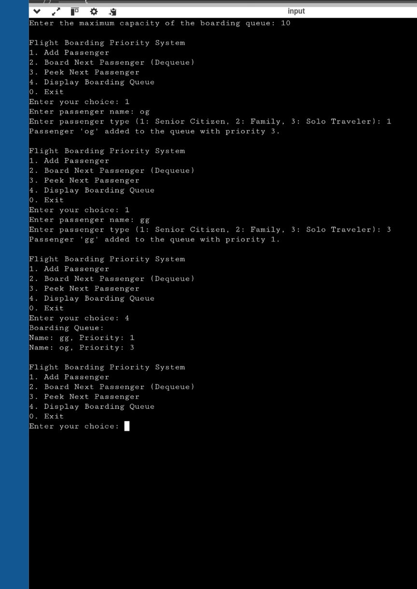
SOURCE CODE AND OUT PUT
https://onlinegdb.com/MTdBMI-NA

Slide 6

CONCLUSION
Implementing flight boarding priority offers a structured approach.Using a priority queue organizes boarding for a smoother flow.This system aims for a less stressful and potentially faster experience for all.

Slide 7
Thank you very much!

